Slide 1
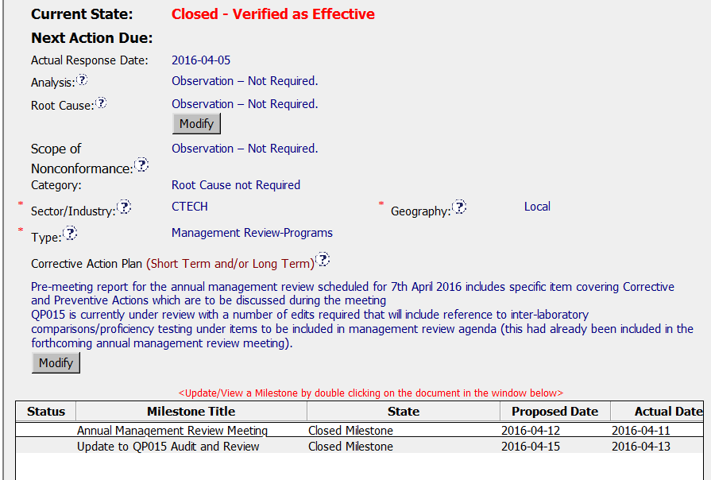
Good that the CAR Champion
put in “Not required” for these fields.
Clear CAP – pre-meeting
Report was a nice addition – shows
That they had a plan to ensure
Everything was discussed.

Slide 2
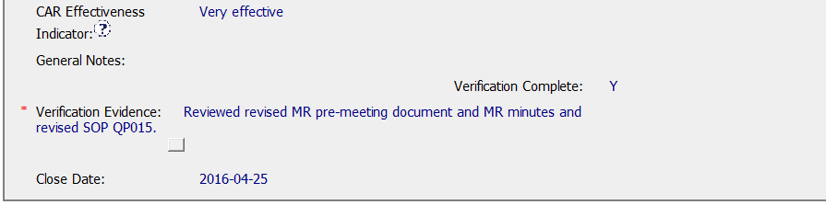
Good – Verified immediately
After closing since OBS.

Slide 3
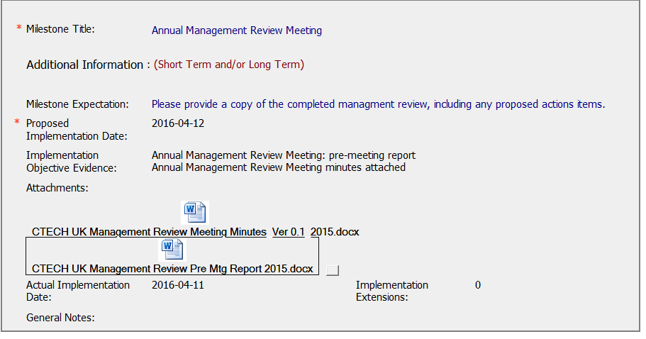
Expectation and evidence are
clear and concise.

Slide 4
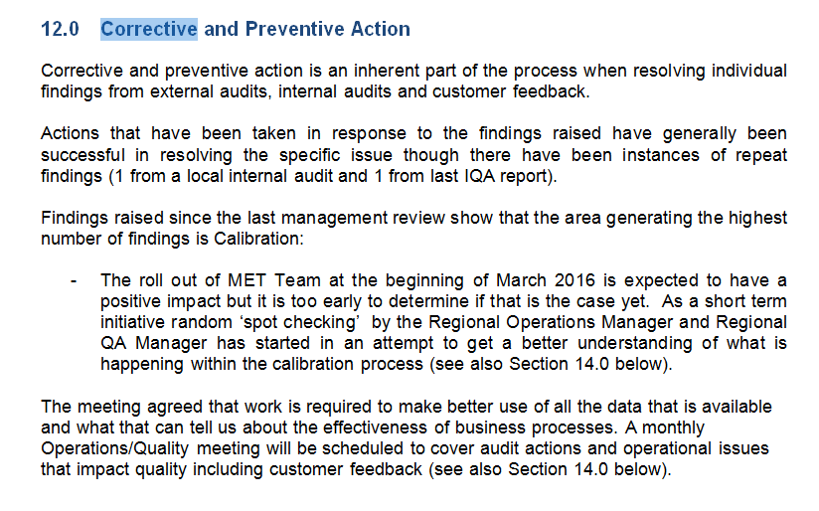
It’s a bit unclear as to which was the
Preventive action – I consider it to be the
Last paragraph, but it might have been nice to
Identify what they considered to be
CA and what they considered to be PA

Slide 5
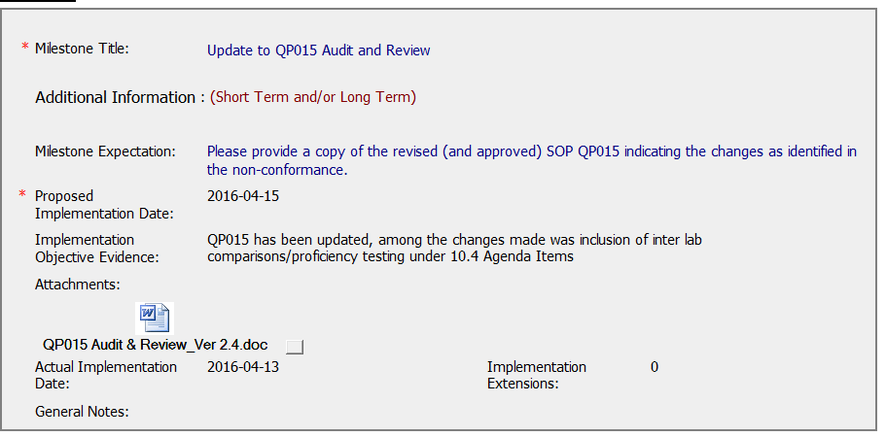
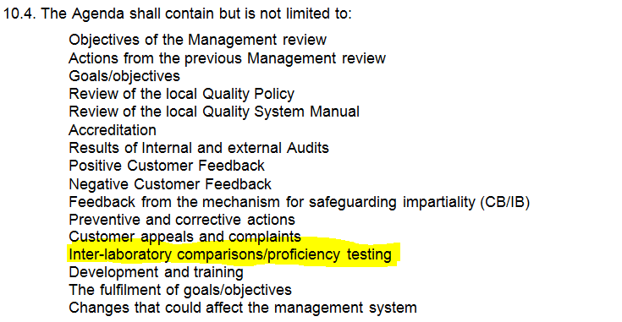
Expectation and evidence
Are clear and concise.

Slide 6
